Slide 1
E-COMMERCE WEBSITE BASED ON RATING SYSTEM
IJAS AHAMMED M
MES20MCA-2021
PRODUCT OWNER: MR SYED FEROZE AHAMED M

Slide 2
TABLE OF CONTENTS
Introduction
Modules
Data Flow Diagram
Table Design
Developing Environment
Product Backlog
User Stories
Project Plan
Sprint Plans
Sprint Actual

Slide 3
INTRODUCTION
The objective of this project is to develop a general-purpose e-commerce store where any product (such as books, CDs, computers, mobile phones, electronic items, and home appliances) can be bought from the comfort of home through the Internet.
An online store is a virtual store on the Internet where customers can browse the catalog and select products of interest. The selected items may be collected in a shopping cart. At checkout time, the items in the shopping cart will be presented as an order. At that time, more information will be needed to complete the transaction.
The System takes review of various users, based on the review, system will specify whether the products and services provided by the E-commerce enterprise is good, bad, or worst. We use a database of sentiment-based keywords along with positivity or negativity weight in database and then based on these sentiment keywords mined in user review is ranked. This system is a web application where user will view various products and purchase products online and can give review about the merchandise and online shopping services. This system will help many E-commerce enterprises to improve or maintain their services based on the customer review as well as to improve the merchandise based on the customer review.

Slide 4
MODULES
ADMIN
Approve shop
View users
Block/Unblock users
View ratings
View complaints and reply
USERS
Registration
View products
Add reviews
view offers
Book products
Send complaint and view reply
View booking status
Send feedback

Slide 5
SHOP
Registration
Add and manage products
Add offers
View rating
View booking
Update status
View feedback
View complaints and send reply

Slide 6
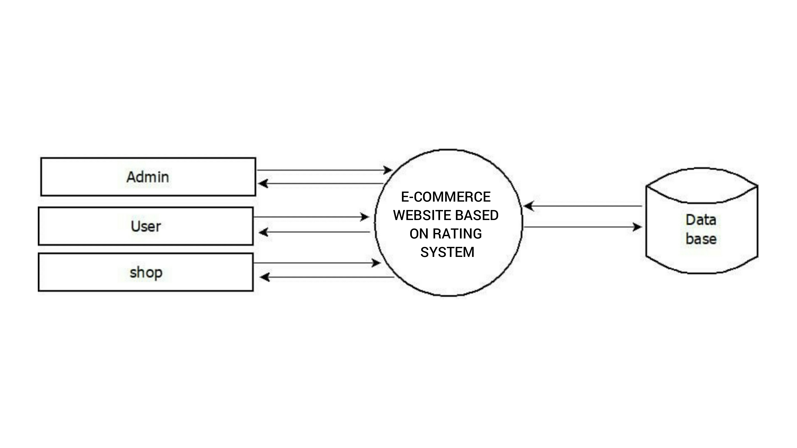
DATA FLOW DIAGRAM
LEVEL 0

Slide 7
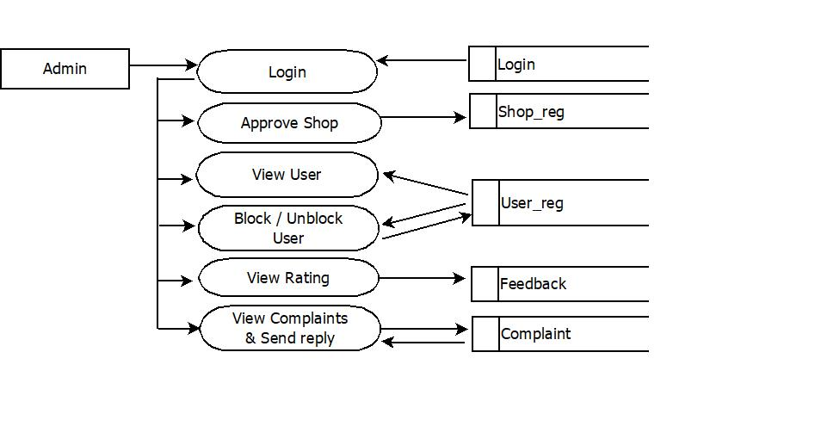
LEVEL 1.1

Slide 8
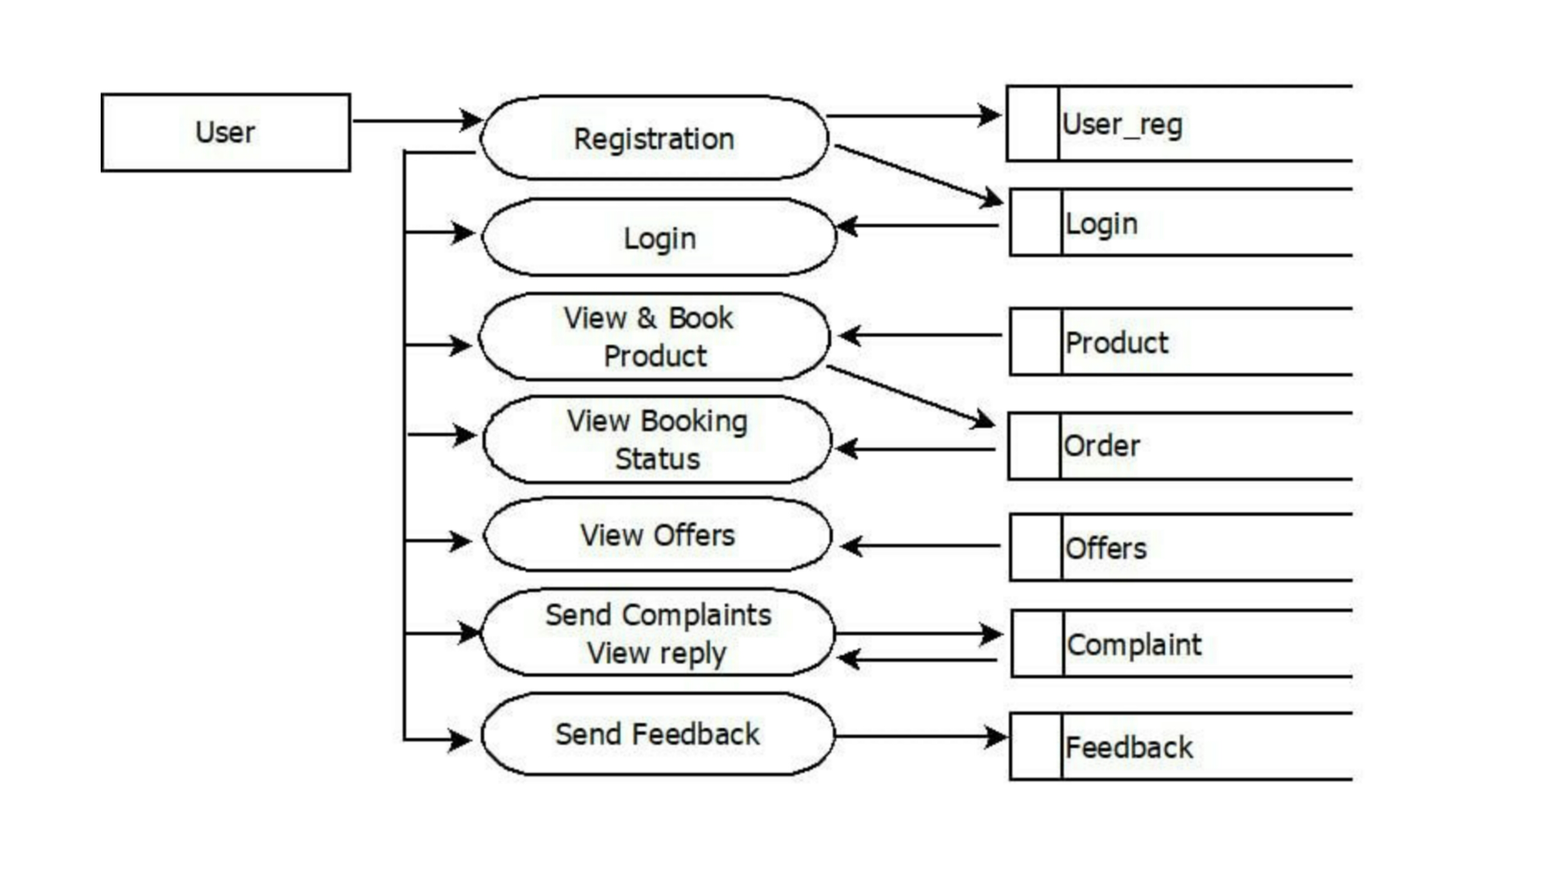
LEVEL 1.2

Slide 9
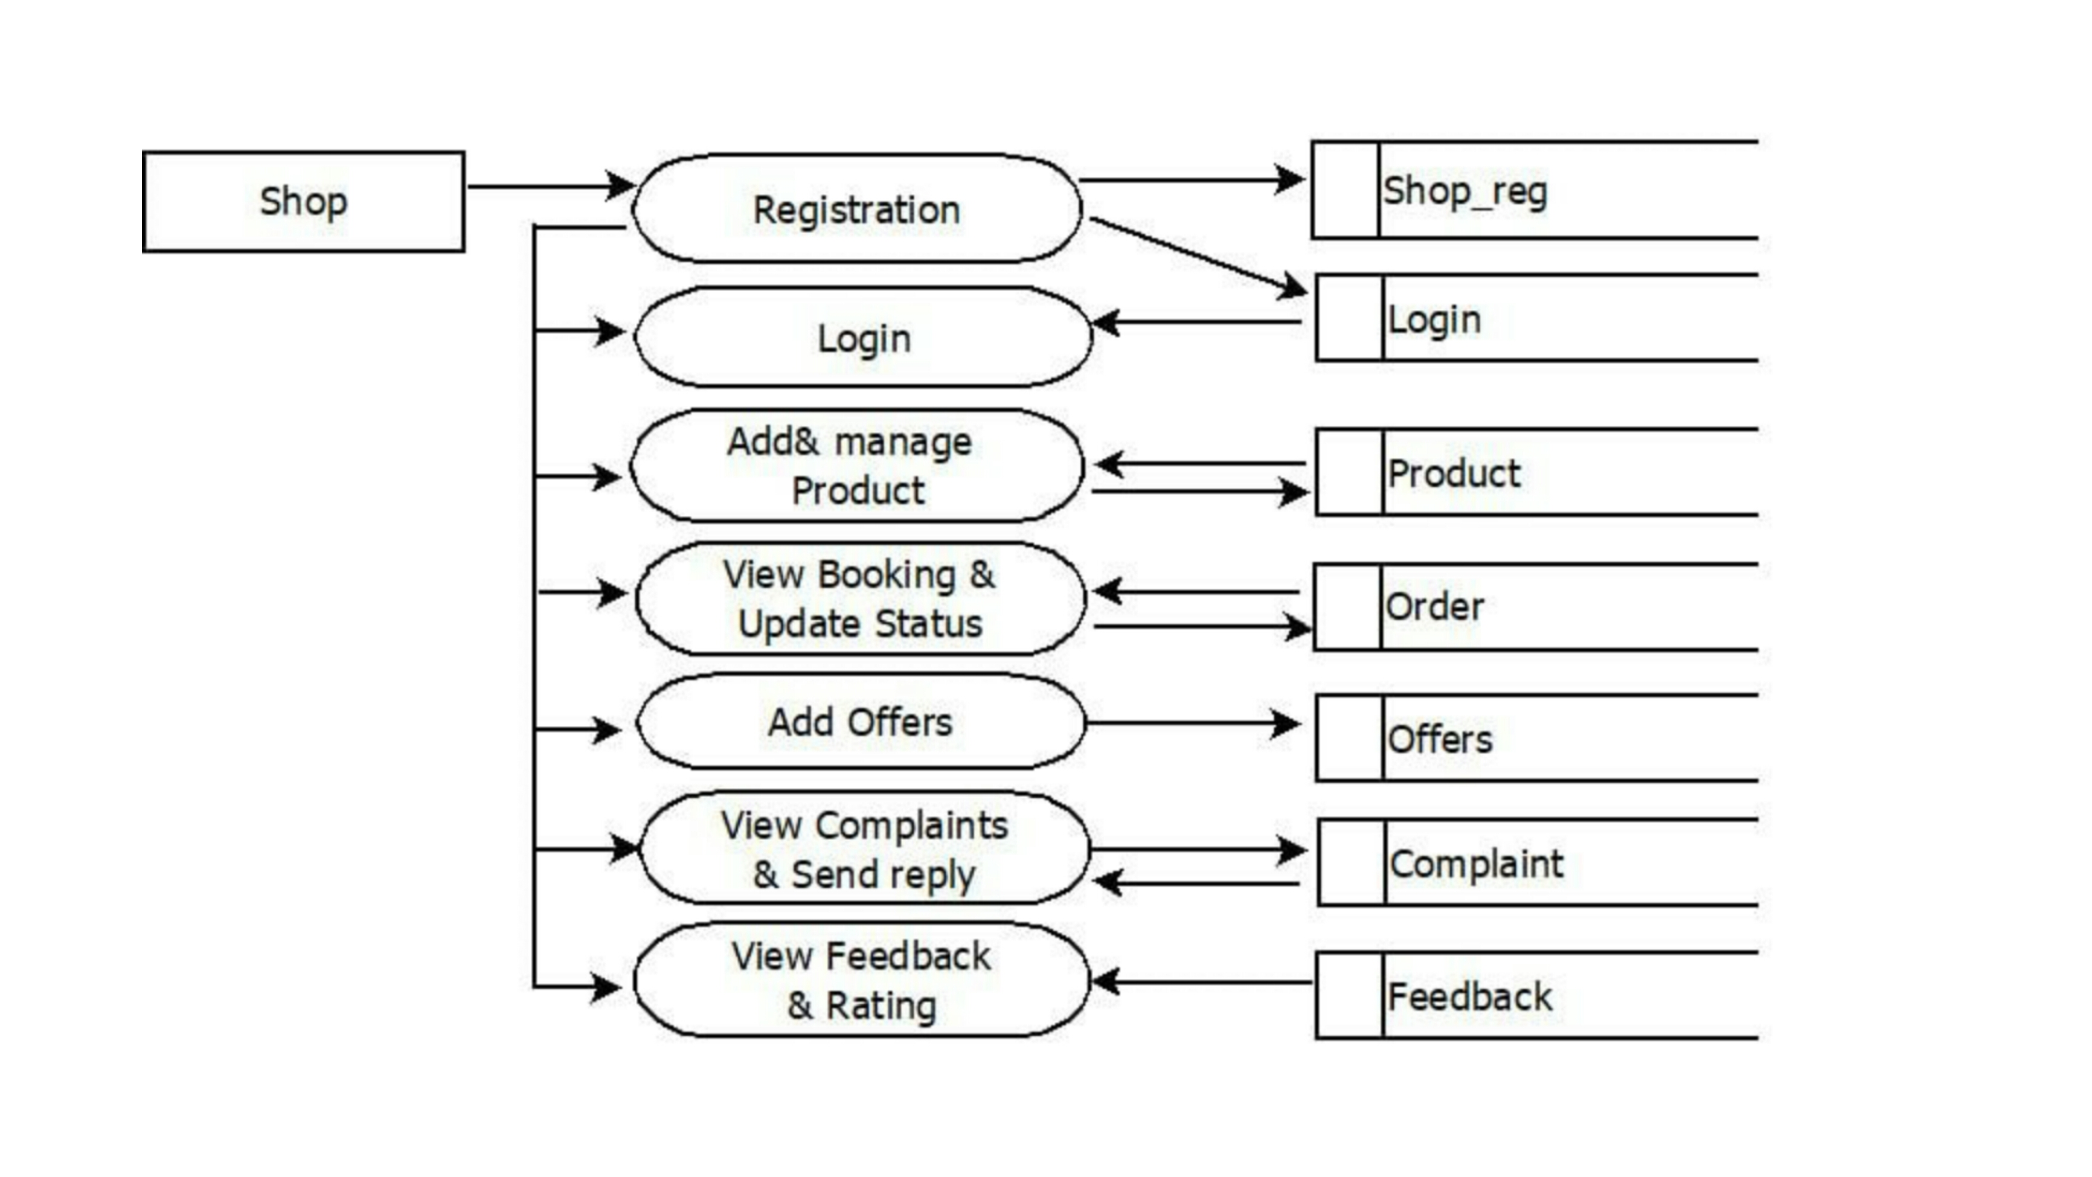
LEVEL 1.3

Slide 10
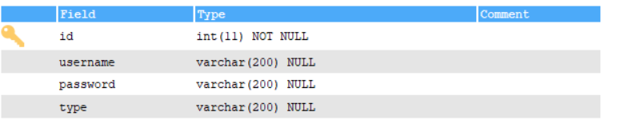
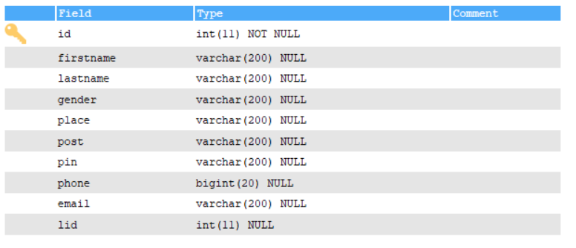
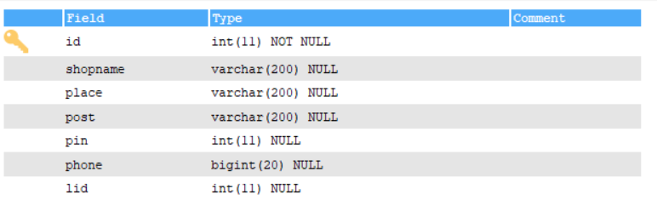
TABLE DESIGN
login
user_reg
shop_reg

Slide 11
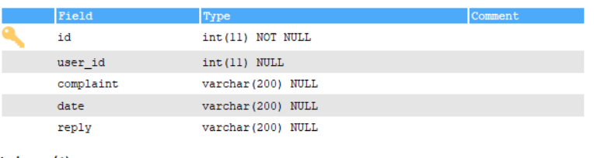
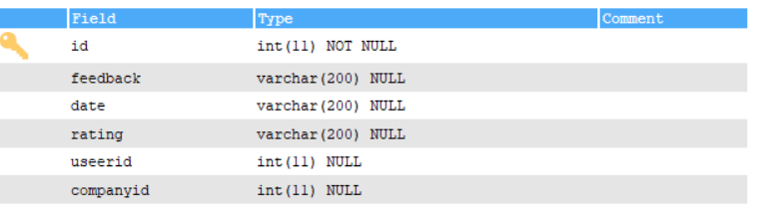
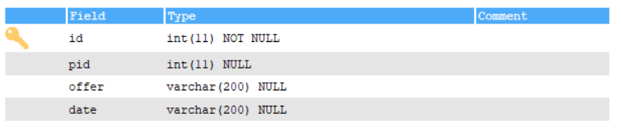
complaint
feedback
offer

Slide 12
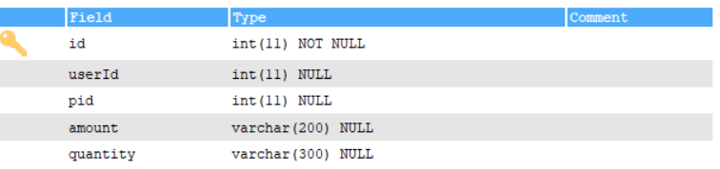
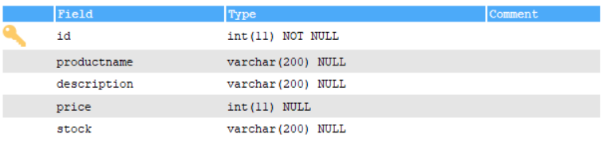
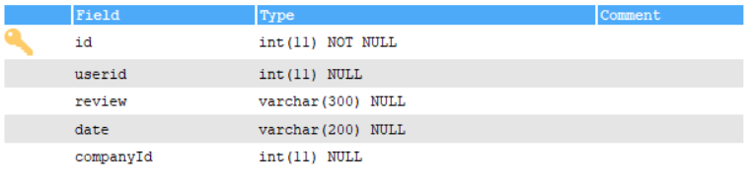
order
product
review

Slide 13
DEVELOPING ENVIRONMENT
Processor - intel x86
Speed - 1.1 ghz
RAM – 700 MB (min)
Hard disk - 150 MB
Key board - standard windows keyboard
Mouse - two or three button mouse
Monitor - SVG
Operating system - windows 7 or above ,android
Frontend - HTML, CSS, JAVASCRIPT
Backend – mysql
Platform used – pycharm , sqlyog
Web browser - google chrome, fire fox, microsoft edge
Frame work - flask

Slide 14
PRODUCT BACKLOG
User Story ID | Priority <High/Medium/Low> | Size (Hours) | Sprint <#> | Status <Planned/In progress/Completed> | Release Date | Release Goal
1 | Medium | 2 | 1 | Completed |  | Table design
2 | High | 3 |  | Completed |  | Form design
3 | High | 5 |  | Completed |  | Basic coding
4 | High | 5 | 2 | Planned |  | Manage products details
5 | Medium | 5 |  | Planned |  | Rating management
6 | High | 5 | 3 | Planned |  | User history mapping
7 | Medium | 5 |  | Planned |  | Recommendation
8 | Medium | 5 | 4 | Planned |  | Testing data
9 | High | 5 |  | Planned |  | Output generation

Slide 15
USER STORIES
UserStoryID | As a <type of user> | I want to | So that I can
1 | Admin | login | Login successful with correct username and password
2 | Admin | view user | View users
3 | Admin | view feedback | View feedbacks from users
4 | Admin | Approve shop | Approve shop of users
5 | Admin | Block unblock users | Block unblock users
6 | Admin | View ratings | View ratings
7 | Admin | View complaints and reply | View complaints and Reply to user
8 | User | Registration | User’s can register with this app
9 | User | login | Login successful with correct Username and password

Slide 16
10 | User | View and book product | User’s can View and book products
11 | User | View offers | User’s can View offers on products
12 | User | Send complaints and View reply | User’s can Send complaints and View reply
13 | User | View booking status | View booking status
14 | User | feedback | Send feedback
15 | Shop | Registration | Registration by given shop details
16 | Shop | login | Login successful with correct username and password
17 | Shop | Add and manage product | Add and manage product
18 | Shop | Add offers | Add offers on products
19 | Shop | View booking and Update status | View booking and Update status
20 | Shop | View feedback and rating | Understand the general idea about the article
21 | Shop | View complaint and Send reply | The admin can redress the grievances of the user

Slide 17
PROJECT PLAN
User Story ID | Task Name | Start Date | End Date | Days | Status
1 | Sprint 1 | 26/12/2021 | 28/12/2021 | 2 | Completed
2 |  | 29/12/2021 | 31/12/2021 | 3 | Completed
3 |  | 03/12/2021 | 08/01/2022 | 5 | Completed
4 | Sprint 2 | 09/01/2022 | 16/01/2022 | 8 | Planned
5 |  | 18/01/2022 | 22/01/2022 | 5 | Planned
6 | Sprint 3 | 23/01/2022 | 27/01/2022 | 5 | Planned
7 |  | 30/01/2022 | 05/02/2022 | 7 | Planned
8 | Sprint 4 | 07/02/2022 | 10/01/2022 | 4 | Planned
9 |  | 17/02/2022 | 20/02/2022 | 4 | Planned

Slide 18
SPRINT BACKLOG PLAN
Backlog Item | Status & completion date | Original estimate in hours | Day1 | Day2 | Day3 | Day4 | Day5 | Day6 | Day7 | Day8 | Day9 | Day10 | Day11 | Day12 | Day13 | Day14
User story #1,#2,#3,#4 |  | hrs | hrs | hrs | hrs | hrs | hrs | hrs | hrs | hrs | hrs | hrs | hrs | hrs | hrs | hrs
Table design | 28/12/2021 | 2 | 1 | 1 | 0 | 0 | 0 | 0 | 0 | 0 | 0 | 0 | 0 | 0 | 0 | 0
Form design | 31/12/2021 | 3 | 0 | 0 | 0 | 1 | 1 | 1 | 0 | 0 | 0 | 0 | 0 | 0 | 0 | 0
Coding | 08/01/2021 | 5 | 0 | 0 | 0 | 0 | 0 | 0 | 0 | 0 | 0 | 1 | 1 | 1 | 1 | 1
User story #5,#6,#7,#8
Manage products details | 16/01/2022 | 5 | 1 | 1 | 0 | 1 | 0 | 1 | 0 | 1 | 0 | 0 | 0 | 0 | 0 | 0
Rating management | 22/01/2022 | 5 | 0 | 0 | 0 | 0 | 0 | 0 | 0 | 0 | 0 | 1 | 1 | 1 | 1 | 1
User history mapping | 27/01/2022 | 5 | 1 | 1 | 1 | 1 | 1 | 0 | 0 | 0 | 0 | 0 | 0 | 0 | 0 | 0
Recommendation | 05/02/2022 | 5 | 0 | 0 | 0 | 0 | 0 | 0 | 0 | 1 | 0 | 1 | 1 | 1 | 0 | 1
Testing data | 10/01/2022 | 5 | 1 | 1 | 1 | 1 | 1 | 0 | 0 | 0 | 0 | 0 | 0 | 0 | 0 | 0
User story #9
Output generation | 20/02/2022 | 5 | 0 | 0 | 0 | 0 | 0 | 0 | 0 | 0 | 0 | 2 | 1 | 1 | 1 | 1
Total |  | 40 | 4 | 4 | 2 | 4 | 3 | 2 | 0 | 2 | 0 | 5 | 4 | 4 | 3 | 4

Slide 19
SPRINT ACTUAL
Backlog Item | Status & completion date | Original estimate in hours | Day1 | Day2 | Day3 | Day4 | Day5 | Day6 | Day7 | Day8 | Day9 | Day10 | Day11 | Day12 | Day13 | Day14
User story #1,#2,#3,#4 |  | hrs | hrs | hrs | hrs | hrs | hrs | hrs | hrs | hrs | hrs | hrs | hrs | hrs | hrs | hrs
Table design | 28/12/2021 | 3 | 1 | 1 | 0 | 0 | 0 | 0 | 0 | 0 | 0 | 0 | 0 | 0 | 0 | 0
Form design | 31/12/2021 | 2 | 0 | 0 | 0 | 1 | 1 | 1 | 0 | 0 | 0 | 0 | 0 | 0 | 0 | 0
Coding | 08/01/2021 | 5 | 0 | 0 | 0 | 0 | 0 | 0 | 0 | 0 | 0 | 1 | 1 | 1 | 1 | 1
User story #5,#6,#7,#8
Manage products details
Rating management
User history mapping
Recommendation
Testing data
User story #9
Output generation
Total |  | 10 | 1 | 1 | 0 | 1 | 1 | 1 | 0 | 0 | 0 | 1 | 1 | 1 | 1 | 1

Slide 20
THANK YOU

